Slide 1
Term Project
Milan Sherman

Slide 2
Research Question: Are the Dallas Cowboys still “America’s Team”?
The Dallas Cowboys were dubbed “America’s Team” in 1978 (Halprin, 2020), implying that they are the most popular NFL team in the nation
As a Pittsburgh Steelers fan, I question this assertion. As long as I have been following the Steelers, they seem to have a very broad fan base; they often have more fans in attendance at an away game than the home team, and I notice people wearing Steelers merchandise across the country.
This evidence is admittedly anecdotal and likely biased
Since, however, the Steelers have never been given a title that would imply that they are more popular than any other team, I thought it would be more interesting to test the claim that the Cowboys are.
Without challenging the 1978 claim, the goal of this study is test whether it is still true by determining whether the Dallas Cowboys have consistently been the most popular team in the NFL over the last decade

Slide 3
Measuring popularity
There are metrics that could be used to measure the popularity of a team that don’t rely on Google trends:
Viewership ratings, e.g., Nielsen ratings for Cowboys’ games
Ticket sales (home and away games)
Team merchandise sales
These metrics rely to a large degree on the size of the market that a team is located in
For example, viewership ratings might be a measure of the number of media outlets covering the Cowboys’ games rather than the Cowboys’ popularity
Google trends could provide insight into a team’s popularity that these metrics may not capture

Slide 4
Social media metrics
A study was recently conducted (2021) that measured relative popularity of every team in the league based on the following social media metrics:
Facebook likes
Twitter followers
Instagram followers
This study used these metrics from 2020, i.e., what teams are most or least popular now
The claim that the Cowboys are “America’s Team” implies that they are more than the most popular team at the moment
As the Cowboys earned this moniker in the 70’s, my goal is to determine whether this is still the case. For this reason I am investigating the Cowboys’ popularity over the last decade.

Slide 5
Study design: Comparison teams
The aforementioned study also helps to identify other teams that might be more popular than the Cowboys. The top four most popular teams were identified (in order) as:
Dallas Cowboys
New England Patriots
Pittsburgh Steelers
Green Bay Packers

Slide 6
Study design: Comparison teams
I believe that an essential part of being a fan of a team is loyalty, i.e., that you are a fan in good times and bad, not just when the team is experiencing success
If we assume that the saying “everybody loves a winner” is true, then a team’s success may be a confounding factor in measuring their popularity
Looking at each of these four team’s on-field success over the last decade, the Patriots, Steelers, and Packers are in the top 10, and the Cowboys are number 11 (Werner, 2020)
However, the Patriots’ domination during this decade was unprecedented in the history of the NFL – they made the playoffs every year, went to the Super Bowl five times, and won it three times.
The Steelers’ and Packers’ success has been much more modest and inconsistent during this time
For this reason I have limited the focus of this study to the Cowboys, Steelers, and Packers
Note: the fact that the Cowboys have been the least successful team during this time could be a confounding factor for the reasons noted above. However, as they are the focus of the study they must be included in the comparison.

Slide 7
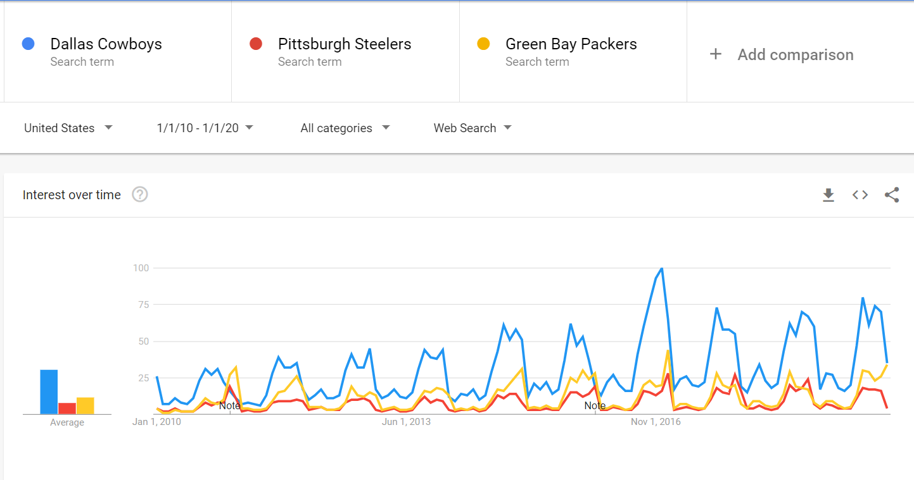
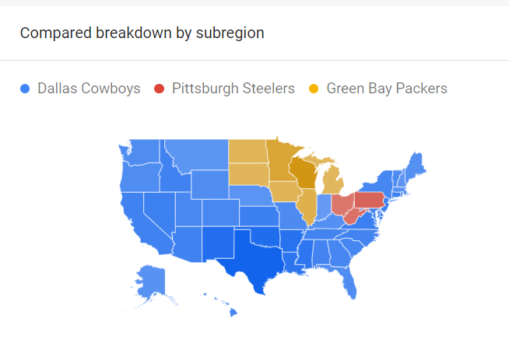
General popularity based searches by team name
In terms of web searches using
each of these teams as a search term
it appears that the Cowboys have
generated more interest than the
Steelers and the Packers.
There is a clearly a seasonal pattern
corresponding to the NFL football
season, but even during the offseason the Cowboys seems to have been more popular.
In addition, looking at searches across the U.S., the Steelers and Packers popularity seems to be regional, while the Cowboys popularity extends beyond the region surrounding Texas.

Slide 8
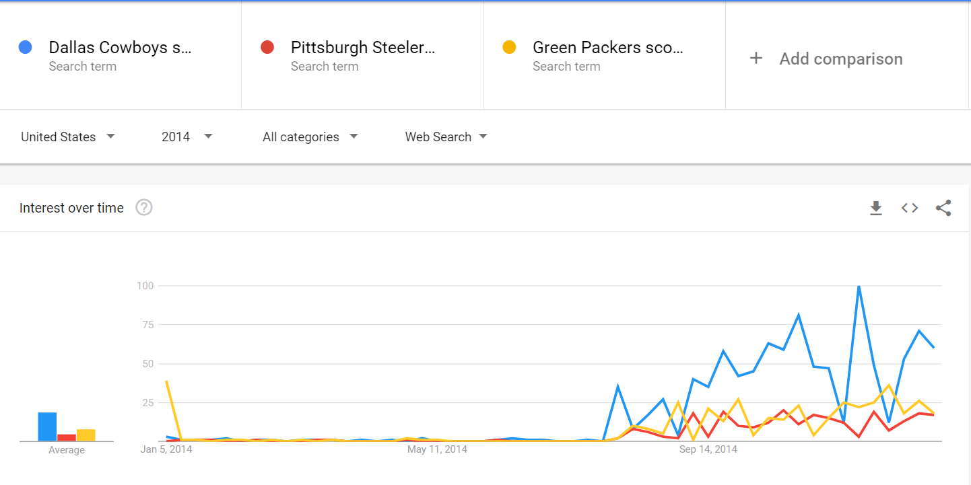
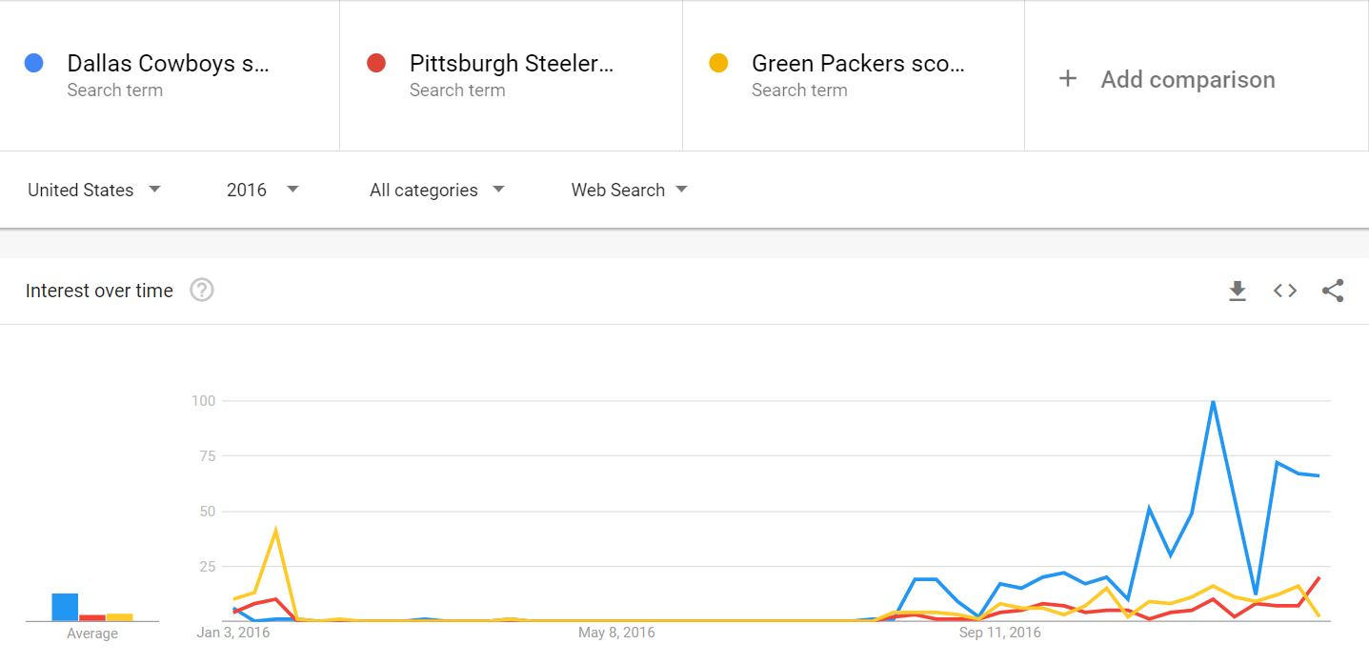
Popularity during successful seasons
In order to make more fair comparisons, we can examine the popularity of seasons (2014 & 2016) where all three of these teams made playoffs
Many times fans can lose interest if their teams are not doing well
However, in the two seasons where all three teams were having a winning season and going to the playoffs, the Cowboys are clearly more popular

Slide 9
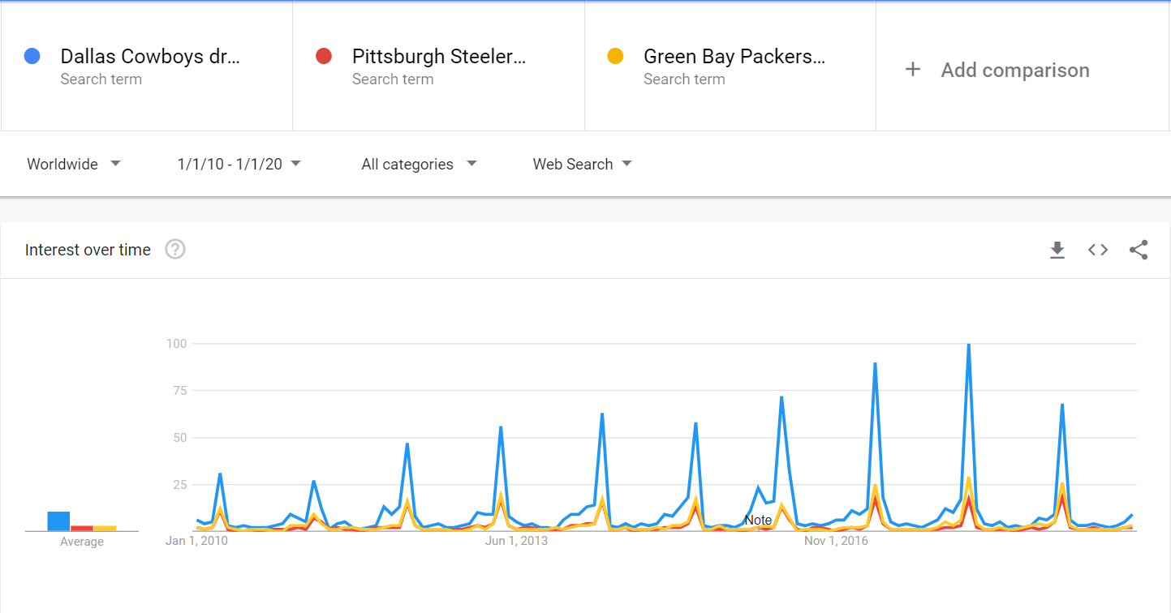
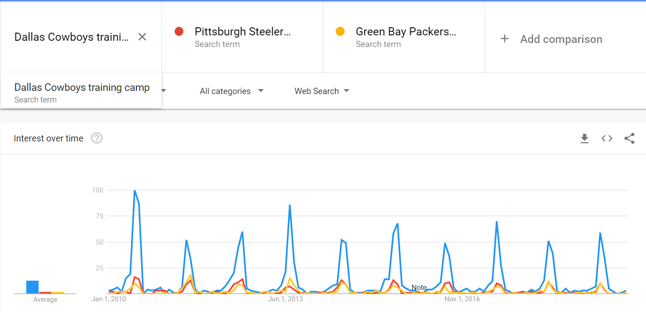
Offseason popularity: the draft and training camp
Another measure of popularity is sustained interest, not just interest during the season
Looking searches associated with each team related to the NFL draft and training camp, two important offseason events, we see that the Cowboys definitely generate more interest than the Steelers and Packers

Slide 10
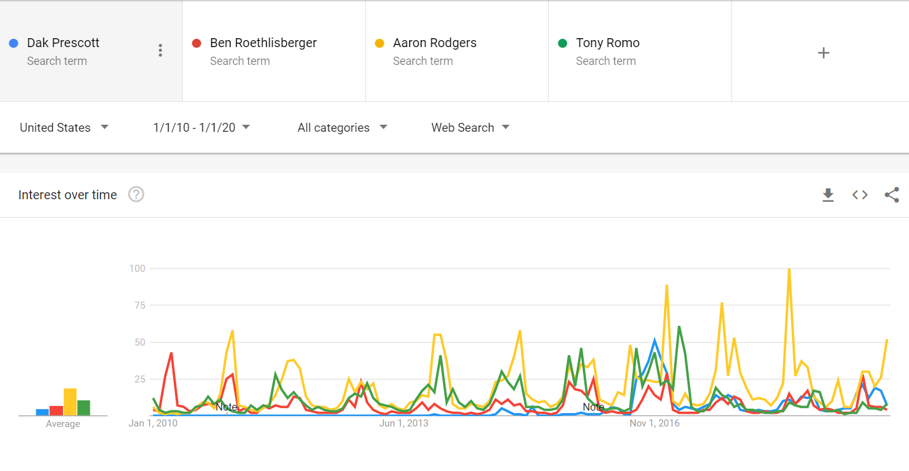
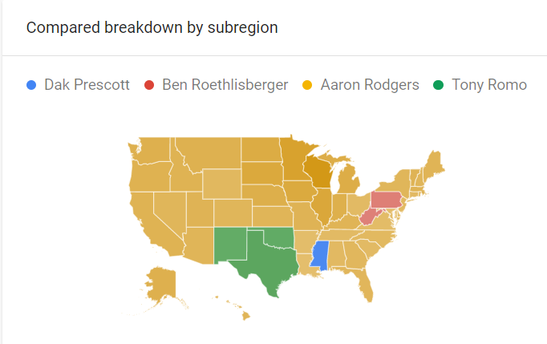
Comparing quarterback popularity
As the quarterback of an NFL team is generally the most recognized player on the team, we look at how popular each of these quarterbacks has been over the last decade
While Ben Roethlisberger and Aaron Rodgers have been the quarterbacks for their teams over the last decade, the Cowboys have had two main quarterbacks during this time: Dak Prescott and Tony Romo
Aaron Rodgers has clearly been the most popular quarterback over the last decade. In light of the previous findings, however, this suggests that the Cowboys are more popular, as their popularity was not based on the popularity of a single player

Slide 11
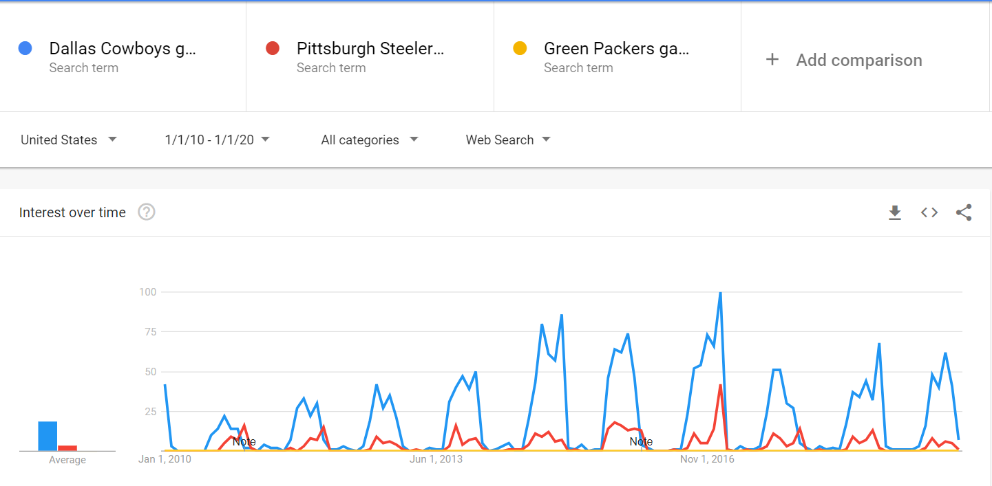
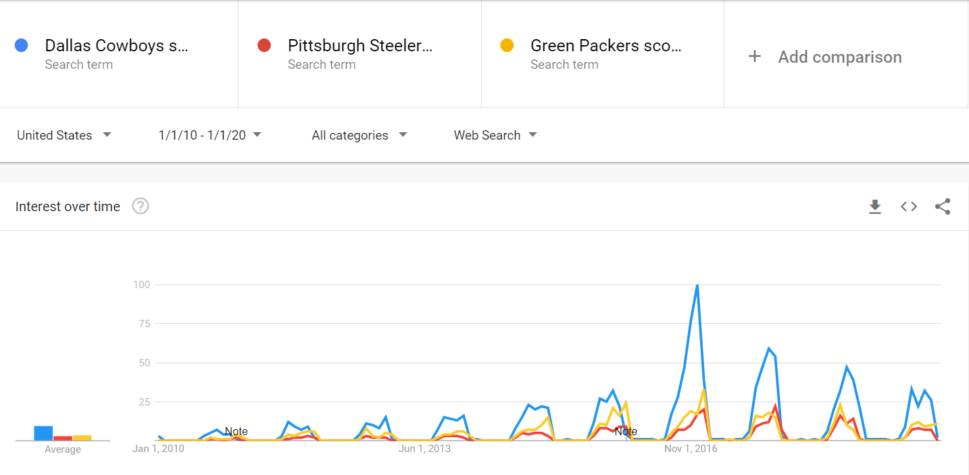
Game schedule and results
While viewership ratings can determine which teams draw the largest TV audience, many fans follow their teams by looking for results online
The top graph shows searches for the game time for each team, and the bottom is searches for game scores
The Cowboys consistently generate more interest in searches for game times
In terms searches for game scores, the Cowboys have definitely generated more interest in the last 5-6 years
The Cowboys made the playoffs twice during this period

Slide 12
Conclusion
Based on searches for each of these teams in season and during the offseason, and in spite of the fact that both the Steelers and Packers have enjoyed more success over the last decade, the evidence from Google trends points to the Cowboys continuing to be “America’s Team” over the last decade
This conclusion corroborates the conclusion based on social media metrics

Slide 13
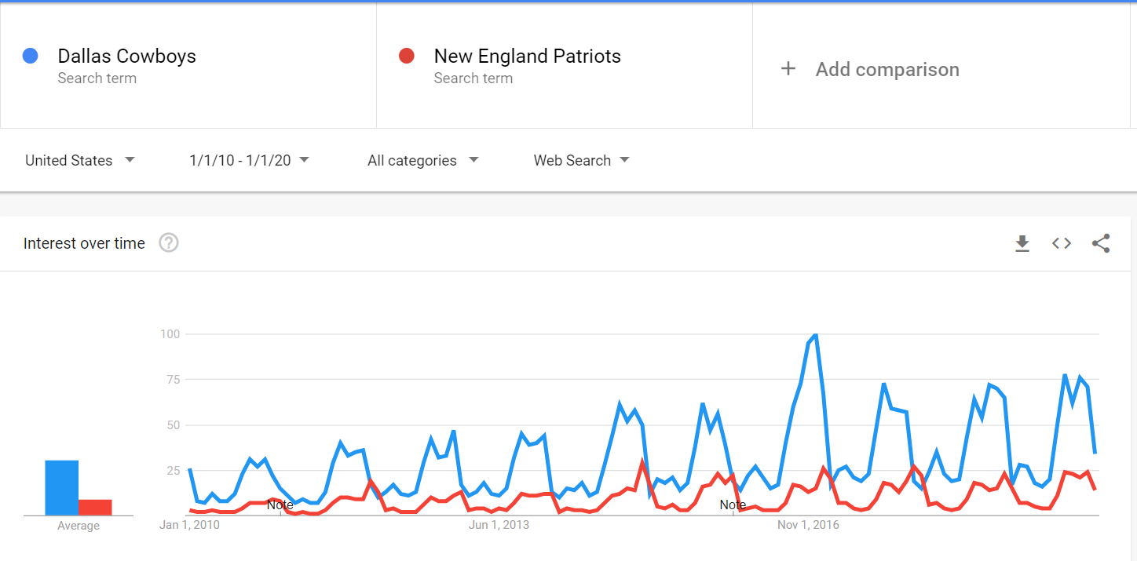
Post hoc analysis: Comparing to the Patriots
Although I had decided to exclude the Patriots from the analysis due to their overwhelming success during the 2010-2020 period, I decided to conduct a post hoc analysis
Surprisingly, the Cowboys seem to be even more popular than Patriots during this period in spite of the Patriots’ overwhelming success

Slide 14
References
The least & most POPULAR NFL teams on social Media [2021]. (2021, April 16). Retrieved April 25, 2021, from https://www.wsn.com/nfl/least-most-popular-nfl-teams-facebook/
Halprin, D. (2020, May 11). Cowboys still America's team, whether they are CONTENDERS or not. Retrieved April 03, 2021, from https://www.bloggingtheboys.com/2020/5/11/21254504/cowboys-still-americas-team-whether-they-are-contenders-or-not
Werner, B. (2020, February 13). Ranking all 32 NFL teams by record in the 2010s decade. Retrieved April 25, 2021, from https://touchdownwire.usatoday.com/2019/12/30/ranking-all-32-nfl-teams-by-record-in-the-2010s-decade/32/

